Slide 1


OxiScience NonScents’ Sales & AdWord Spend Group 3 Roger André, Molly Gordon, Shilpi Gupta, Amanda Jaeger

Slide 2
What is OxiScience?
Molly to jazz up this slide. Analyze sales dataset to identify insightful graphs to use here. Use puns and play on words w/ the interesting products ☺
Overview & Business Problem
Sales Summary
Local startup specializing in kitty litter and other odor control products
NonScents brand
Founded in January 2015
9 product groups (insert No. 2 Toilet Spray joke ☺)
eCommerce sales - Amazon
Reporting currently done ad hoc in Excel
Lack insights on effectiveness of Google AdWords
No dedicated BA or data analyst
Insert sales by product summary from
Pie chart?
Other ideas: summary by geo date, monthly sales, etc

Slide 3


The Dataset
Not sure where this should go, but think the visual may help
We examined NonScents’ sales order and Google AdWords data for the company from July – early November 2017 (period due to a different budget landscape prior to July).
Sales Orders:
e.g. Date, Product Price, Qty, Shipping Address
AdWords:
Date, Cost, Clicks
Merged dataset:
AdWords, Aggregate Revenue, Calculations

Slide 4
Ask Question(s)
Does Google AdWord spend have an impact on Sales?
Ask Questions
Wrangle Data
Explore Data
Draw Conclusion
Communicate Findings
Considerations
Timing (e.g. day of week)
Order placement v order fulfillment
Assumptions:
AdWord payment for clicks
Order placement is a measure of effectiveness

Slide 5
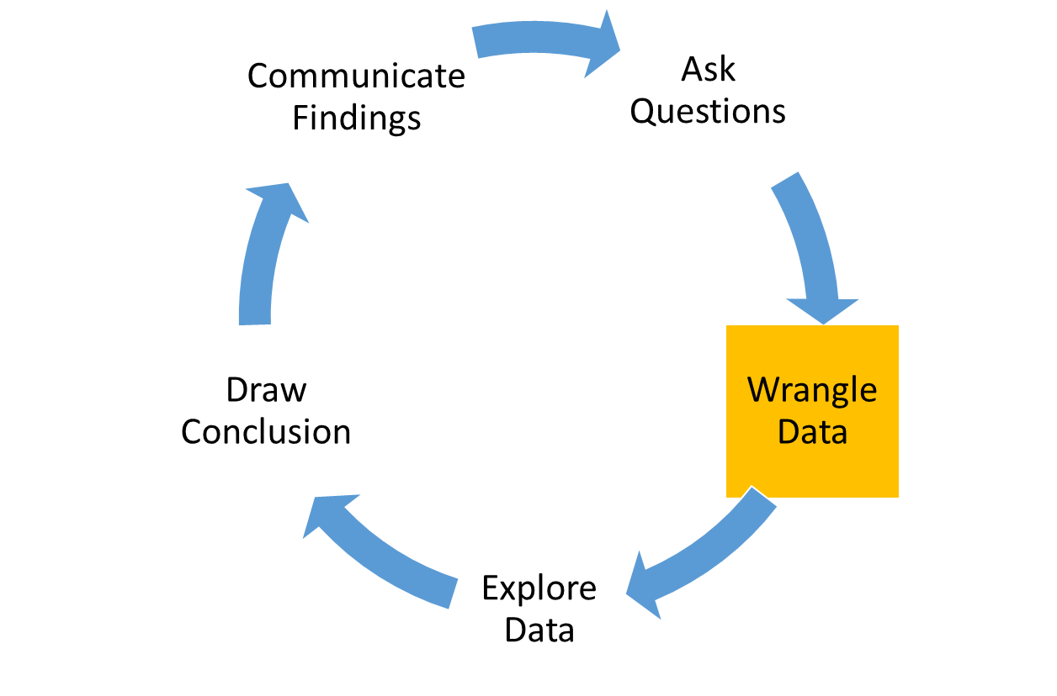
Wrangle Data
Select Columns
Set Data Types
Perform Calculations
Currency conversion (CAD → USD)
Revenue and Quantity aggregate
Clean Data
Remove sample orders ($0 item price)
Narrowed dataset from 35 to 14 columns
Reviewed each column in our datasets to determine which were useful for our analysis
Join Data
Address outliers (“Shipping” status)
Convert date fields to common format with YMD
Product name mapping
Rename to meaningful column names
Merge sales (aggregate) and AdWord datasets
Perform additional calculations on merged data
Join on Date
Cancelled order quantity aggregate
Identify and set categorical data (e.g. Status, Product, Country)
Derive day of week, week number, month

Slide 6
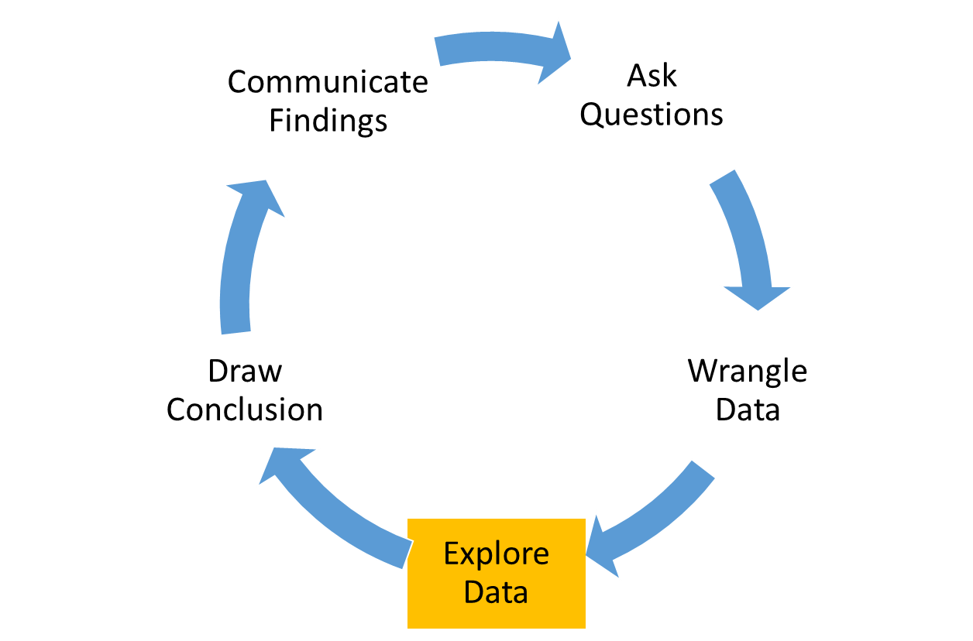
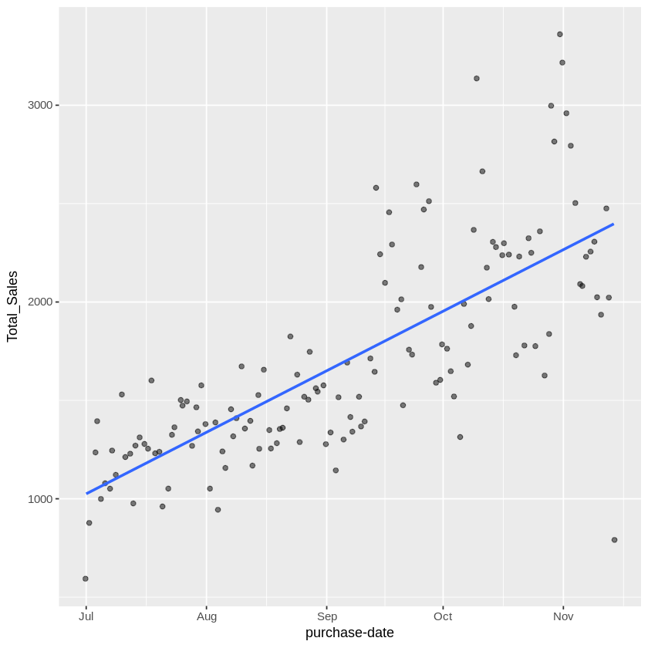
Explore Data
Placeholder for different graphs and tests we run
Possible graphs:
Total sales by time – use most interesting: Day, Day of week, week #, month
Total orders placed (including cancelled) by clicks per day
Average Revenue per AdWord $ spend by time
Example graph only – needs labels, etc

Slide 7
Explore Data cont.
Possibly include a graph like this from R. Show other graphs on prior slide and then here we show effect when examining sales and AdWords on one graph
Regression analysis results?

Slide 8
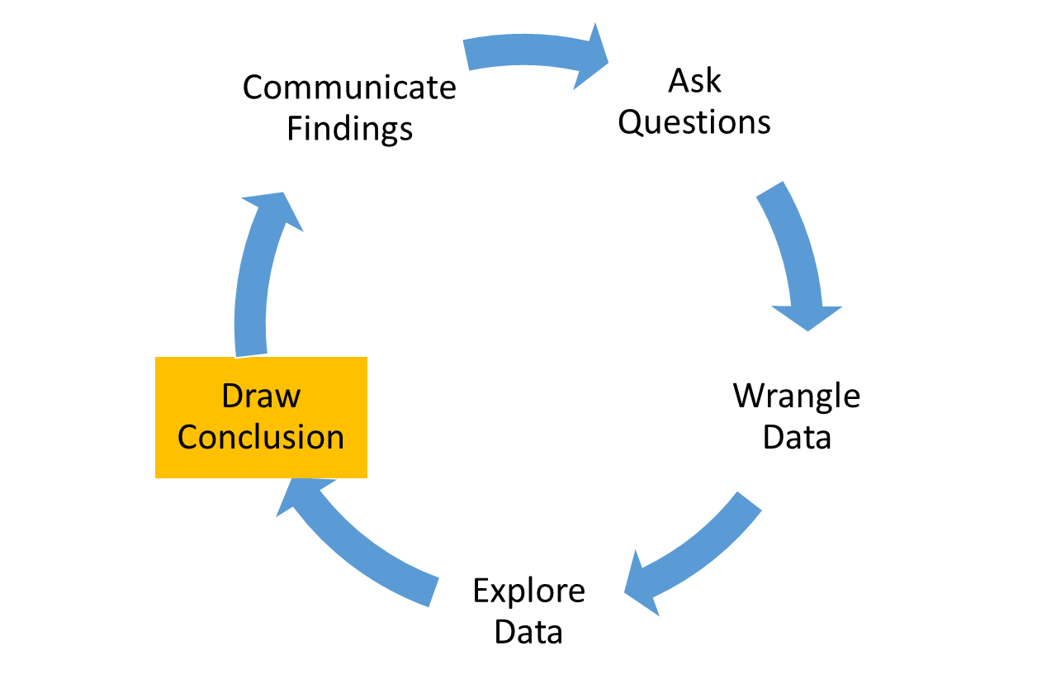
Draw Conclusion
Does AdWord spend = $$
ROI?
Guidance on most effective times for spend if applicable

Slide 9
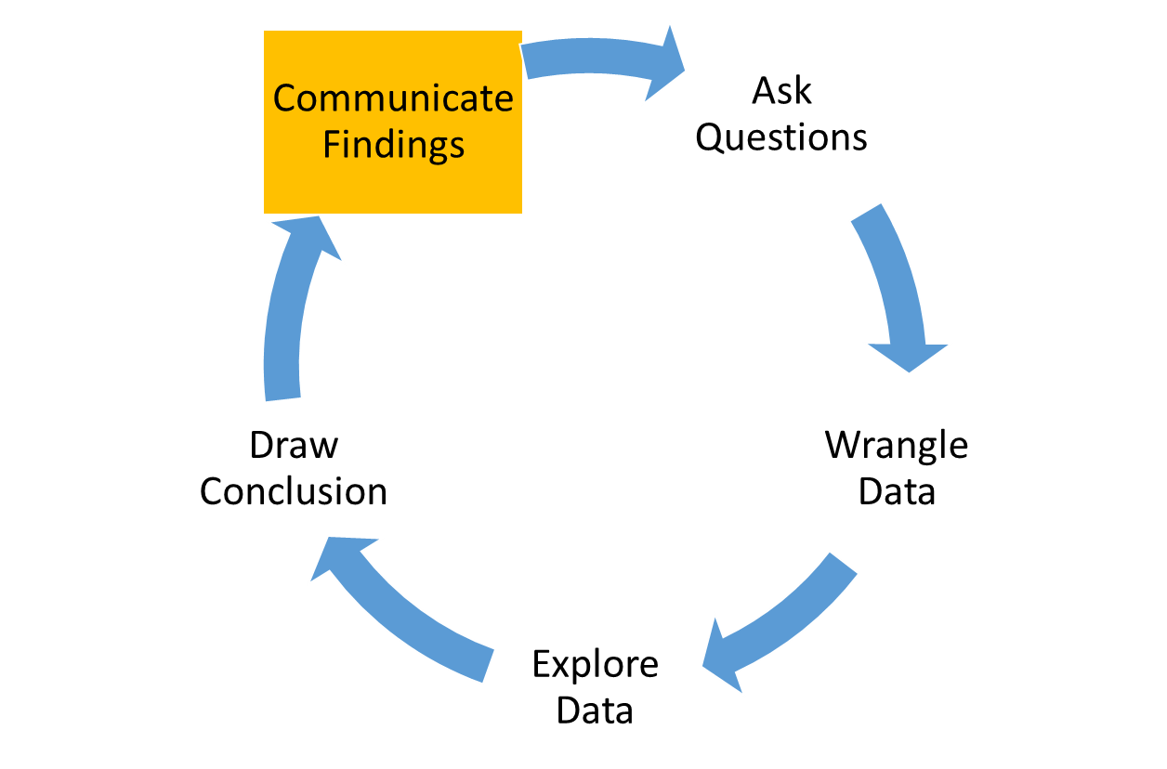
Communicate Findings

Slide 10
Recommendations
Placeholder for any recommendations we may make to OxiScience – e.g.
Standardize product naming convention in Amazon
Expand on our work to build monthly, quaterly, etc reporting mechanism
A / B testing for keywords

Slide 11
R Code
Highlights
Attachment

